Slide 1

Questions with Any, Some, How Much, How Many; Quantity Expressions
10
Home Improvement
Focus on Grammar 2
Part X, Unit 33
By Ruth Luman, Gabriele Steiner, and BJ Wells
Copyright © 2006. Pearson Education, Inc. All rights reserved.

Slide 2

Home Sweet Home
Do you have any plans for this?
Look at that house! It’s awful! Why did you buy it?
How much money do we need to fix it?
We can fix it and then sell it.
Well, not very much. We can do all the work ourselves.
How many months do we need to fix it?
Do you have some aspirin? I have a terrible headache.
Two years!?!
Oh, maybe two years.

Slide 3

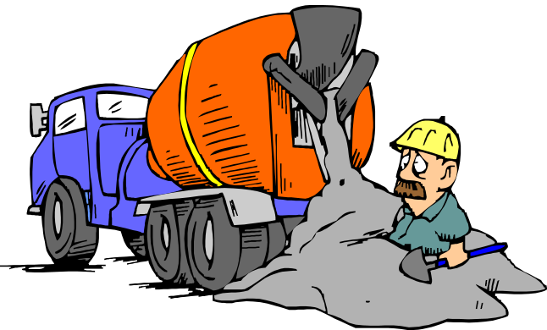
Some
We use some in yes/no questions with plural count nouns and non-count nouns when we offer something or ask for something.
Count
Do you want some nails?
Non-Count
Can I get some cement?

Slide 4
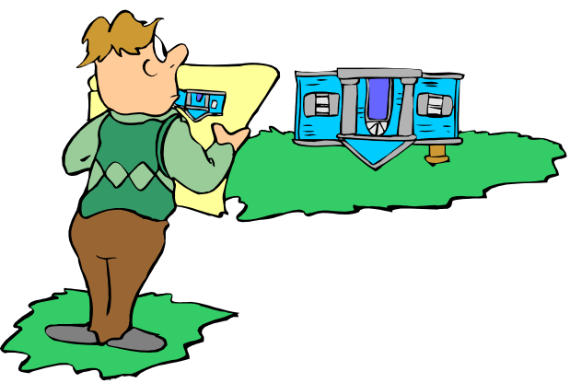
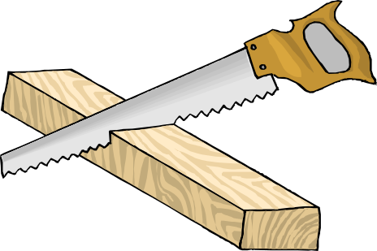
Any
We use any in yes/no questions with plural count nouns and non-count nouns.
Plural Count
Does the house have any problems?
Non-Count
Did you find any wood?

Slide 5


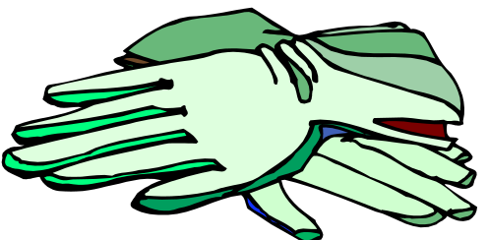
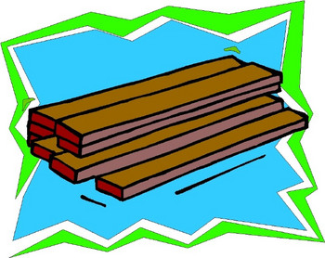

Practice 1
Make yes/no questions about the pictures. Use some or any with count and non-count nouns.
Questions: Would you like some/any ________?
Do you need some/any ________?
Did you buy some/any ________?
Example:
Would you like any screws?
Do you need some screws?
Did you buy any screws?
1.
2.
3.
4.

Slide 6


How much
Use how much to ask about non-count nouns. You can use measure words or containers in your answers.
Non-Count
Just a little. Maybe one can. It’s very expensive.
How much pink paint would you like?

Slide 7

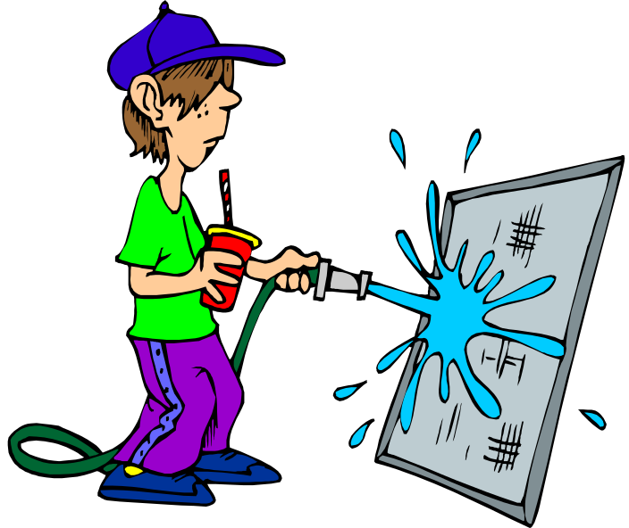
How many
Use how many to ask about count nouns. You can use measure words or containers in your answers.
Count
Oh, a few. About 50.
Dude, how many windows do I need to wash?

Slide 8

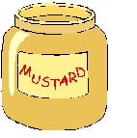
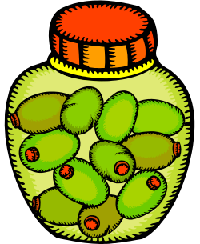
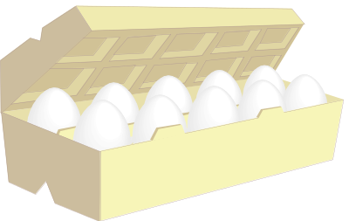



Practice 2
Choose the correct question for each picture. Ask and answer the questions with a partner.
Example:
How much____ is there?
How much flour is there?
How many____ are there?
1.
2.
3.
5.
6.
4.

Slide 9
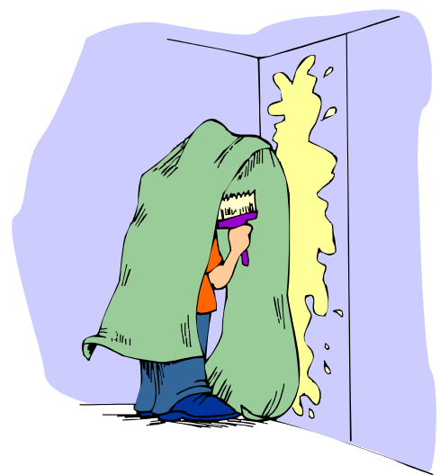
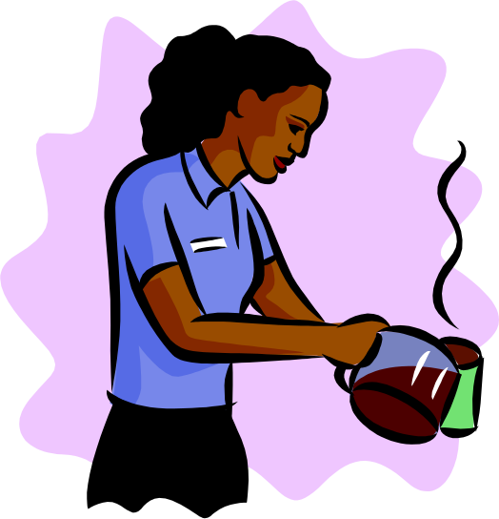
Measure Words and Containers
You can count non-count nouns by using measure words or containers.
Non- Count
I’m pouring a cup of coffee.
I need a roll of wallpaper.
Non-Count

Slide 10
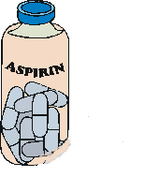
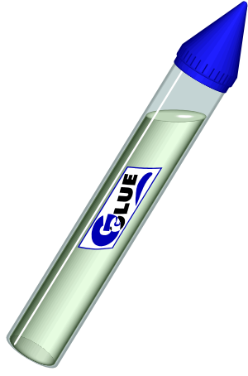
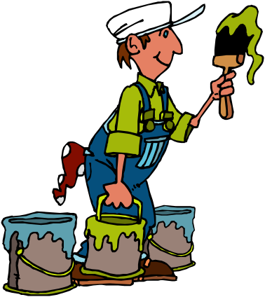
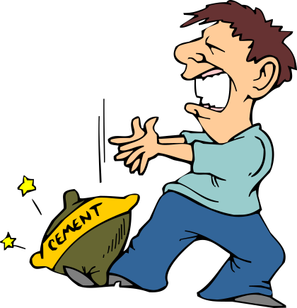
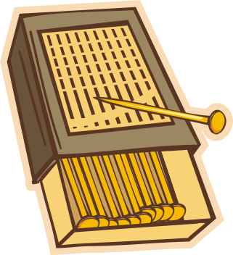
Talk with a partner. Use measure and container words to describe the pictures.
Practice 3
Aspirin
Example:
two bottles of aspirin
1.
2.
3.
4.

Slide 11
References
Copyright © 2006 Pearson Education and its licensors. All rights reserved.

